Slide 1





Efficient Multi-image Correspondences for On-line Light Field Video Processing
Ł. Dąbała^{1,2}, M. Ziegler³, P. Didyk^{1,4}, F. Zilly³, J. Keinert³
K. Myszkowski¹, H.-P. Seidel¹, P. Rokita², T.Ritschel⁵
¹MPI Informatik, ²Warsaw University of Technology, ³Fraunhofer IIS,
⁴Saarland University, ⁵University College London

Slide 2
What is a Light Field?
All Light Rays passing through a surface such as a window
Light-rays can be parameterized by 4D function:
  Position of pinhole (2 params) within 2D surface
  Position of the pixel (2 params) on 2D sensor
Virtual Camera at new position
Virtual Depth-of-Field using Synthetic Aperture

Slide 3
Concept of Light Fields
Virtual Camera
Traditional Camera
Light Field Camera

Slide 4
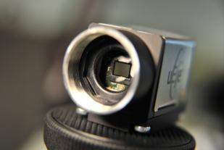
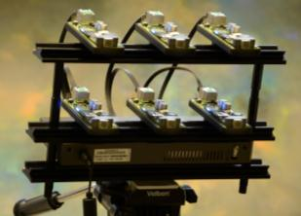
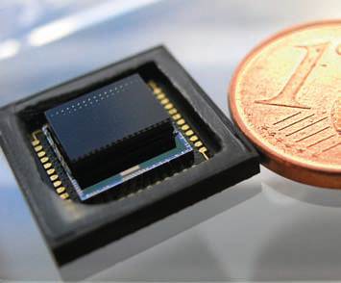
Concept of Light Fields
Light field acquisition workflows and devices based on
  Plenoptic cameras, based on micro-lens arrays (e.g. Raytrix, Lytro Illum)
  Camera arrays (IIS, Stanford) ← our choice
  Cluster eye cameras, multi-aperture optics (Fraunhofer IOF, Pelican Imaging)
New possibilities for the Media Production:
  Synthetic Aperture, Refocus
  Depth Based Compositing
  Virtual Camera Movements
  Allows for 6 Degrees of Freedom VR Rendering
  → Requires sufficient parallax

Slide 5
Light Field Acquisition Using Camera Arrays
View point flexibility
  Angular
  Positional
Large Array:
+ Viewpoint Flexibility
+ Image Quality
- Storage & Resources
Sparse Array:
+ Viewpoint Flexibility
+ Storage & Resources
- Image Quality
Small Array:
+ Image Quality
+ Storage & Resources
- Viewpoint Flexibility
Storage and hardware resources
Image quality
  Dense light field sampling

Slide 6
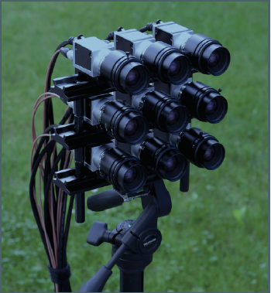
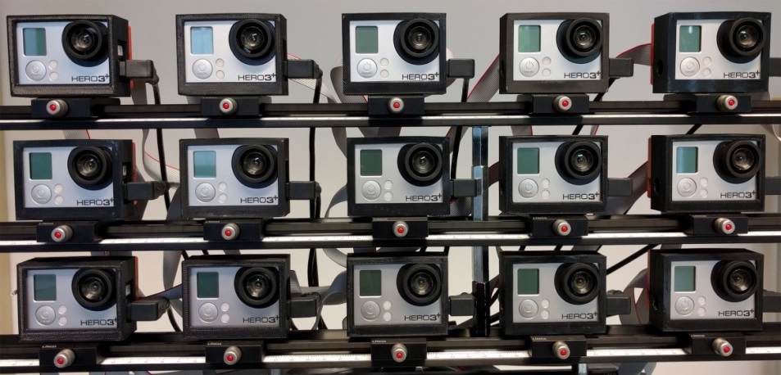
Our capture
9 industrial cameras (Basler acA2000-50gc)
  3x3 arrangement
Up to 16 video cameras (GoPro Hero3+ Black Edition)
  3x5 or 4x4 arrangement

Slide 7
Upsampling a Sparse Light Field
Camera array captures sparse light field
  Not suitable for image based rendering
  Efficient way for upsampling lightfield data is required
More Images
Less Images
Depth Image Based Rendering
Less Geometry
Self Calibration
Disparity Estimation
More Geometry
Rendering with no geometry
Rendering with Implicit geometry
Rendering with Explicit geometry
Picture inspired by Chan, Shum, Ng, Image-Based Rendering and Synthesis, IEEE SIGNAL PROC. MAG., Nov. 2007

Slide 8
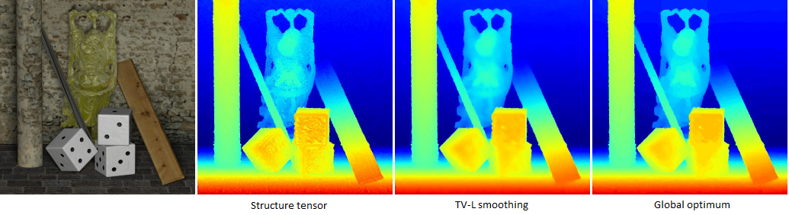
Light Field depth estimation
Wanner et al. Variational Light Field Analysis for Disparity Estimation and Super-Resolution

Slide 9
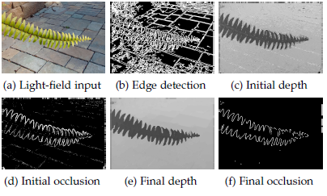
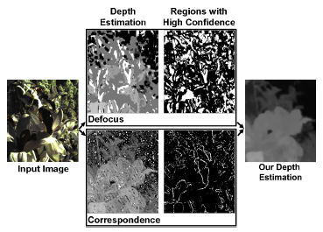
Light Field depth estimation
Wang et al. Depth Estimation with Occlusion Modeling Using Light-field Cameras
Tao et al. Depth from Combining Defocus and Correspondence Using Light-Field Cameras

Slide 10
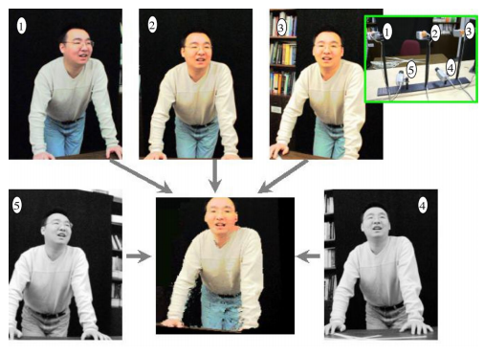
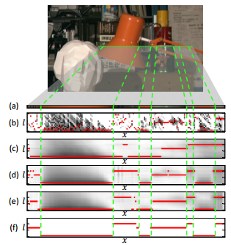
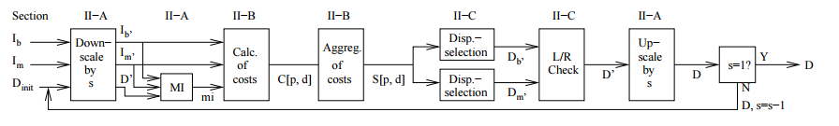
Large Baseline Correspondences
Yang et al. Real-Time Consensus-Based Scene Reconstruction using Commodity Graphics Hardware
Rhemann et al. Fast Cost-Volume Filtering for Visual Correspondence and Beyond
Hirschmueller et al. Stereo Processing by Semi-Global Matching and Mutual Information

Slide 11
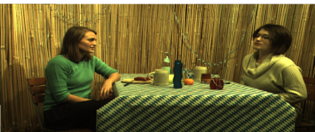
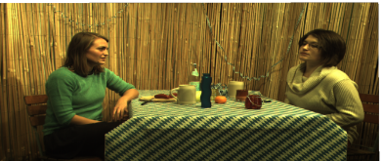
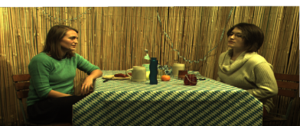
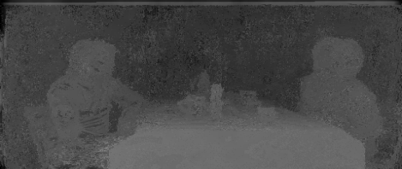
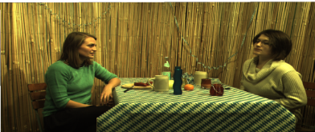
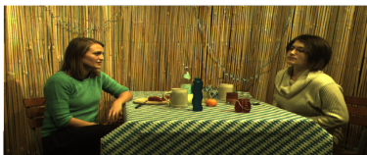
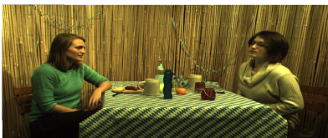
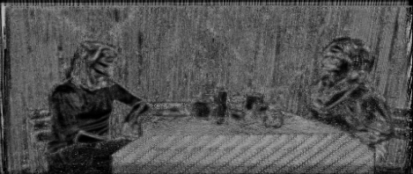
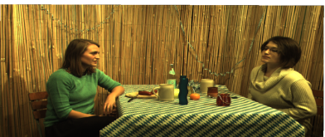
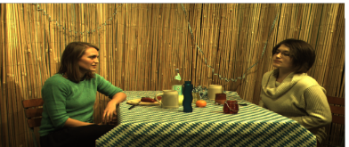
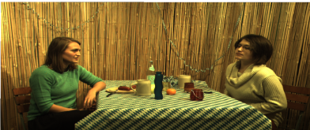
Pipeline Overview
Capture
Matching
Matching result

Slide 12
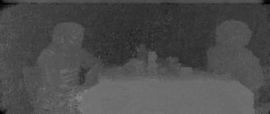
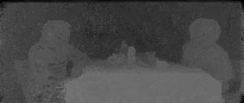
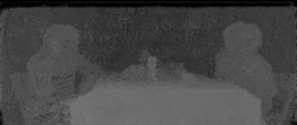
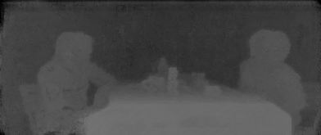
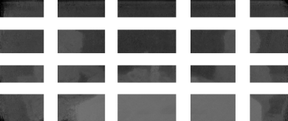
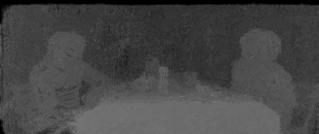
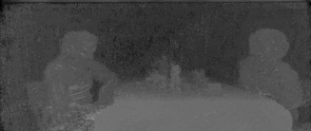
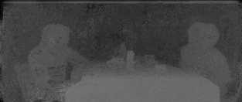
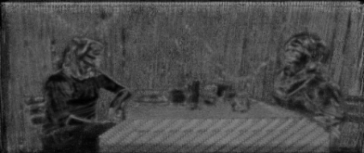
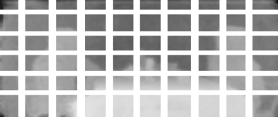
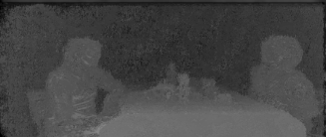
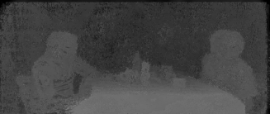
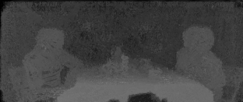
Pipeline Overview
Consolidation
Consolidation result
Upsampling

Slide 13
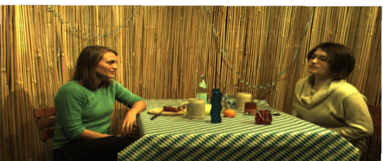



Preprocessing
Gaussian kernel
Census transform
127 | 127 | 129
126 | X | 129
127 | 131 | 131
$$X≥Y$$
X = 128
1 | 1 | 0 | 1 | 1 | 0 | 1 | 0 | 0

Slide 14
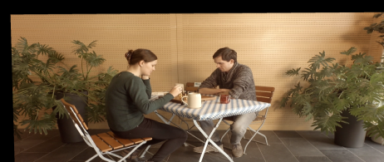
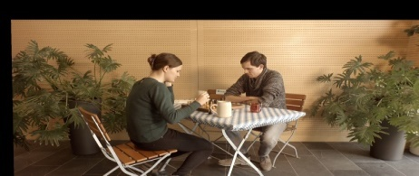
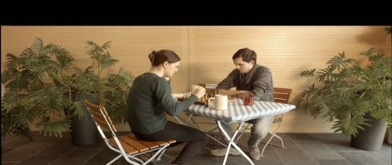
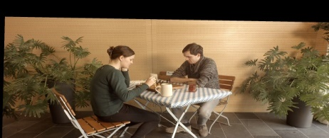
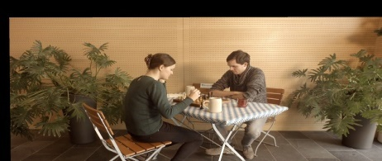
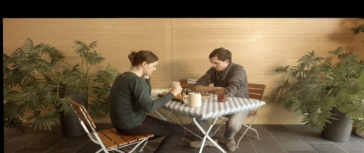
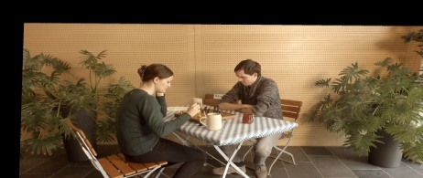
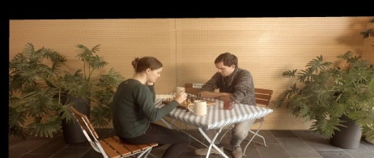
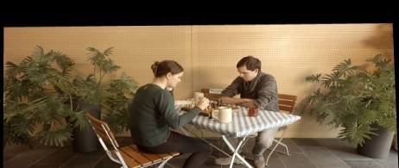
Matching
?

Slide 15





Matching
$$r_{i,i_{2}}$$
$$r_{i,i_{2}}$$
$$r_{i,i_{2}}$$
$$r_{i,i_{2}}$$
$$↑{D_{i}}_{}^{j−1}$$

Slide 16


Matching Confidence
$${\overline{C_{i}^{}}}^{\left(j\right)}\left(x\right)=1 − \frac{1}{1+ σ_{m}{h_{i}}^{(j)}(x)}$$
$${h_{i}}^{(j)}={\left|average cost −best cost\right|}^{1/2}$$

Slide 17
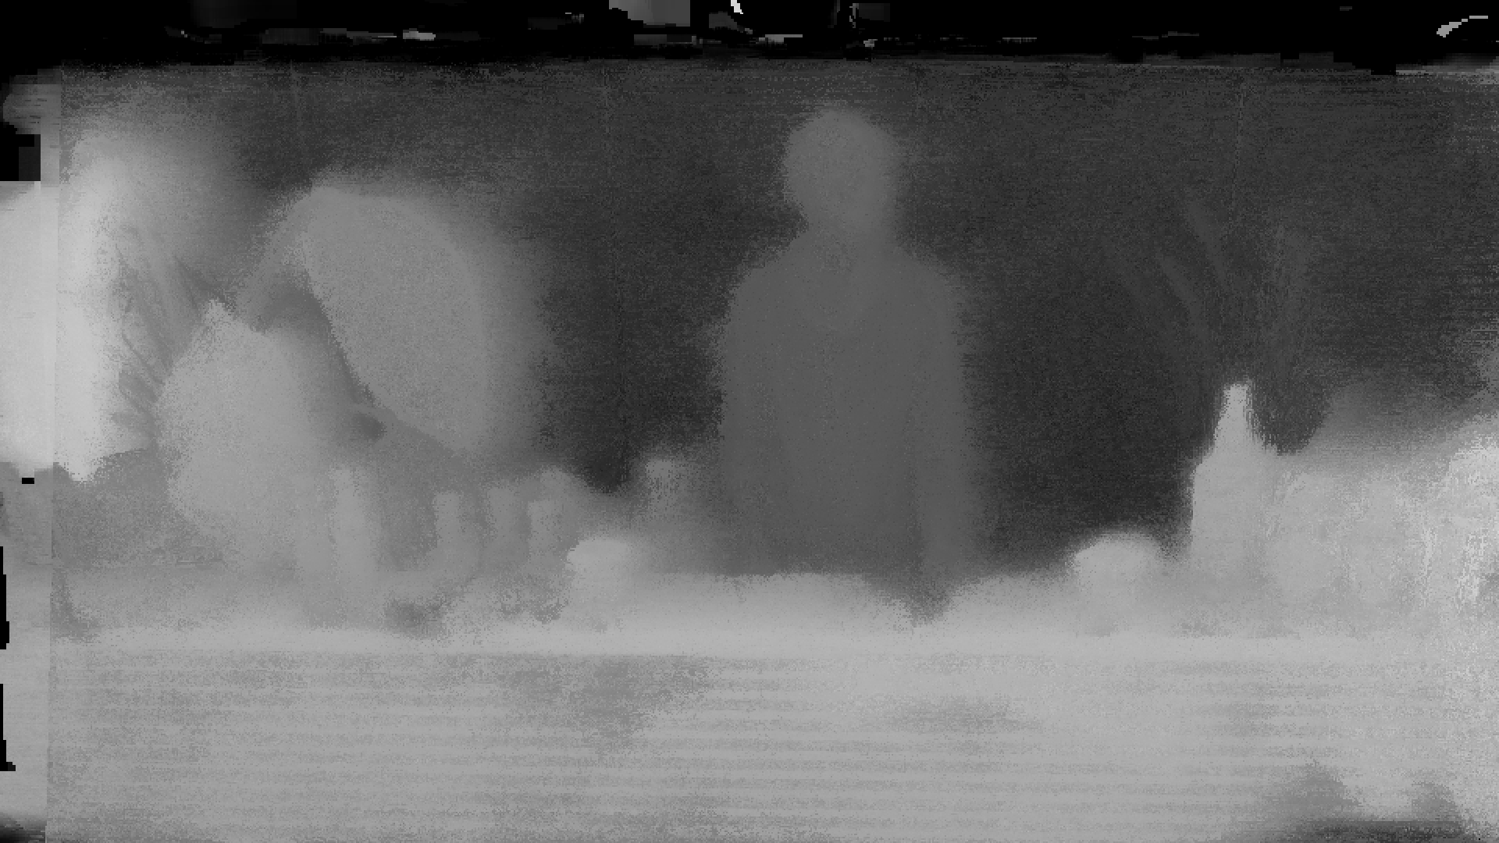
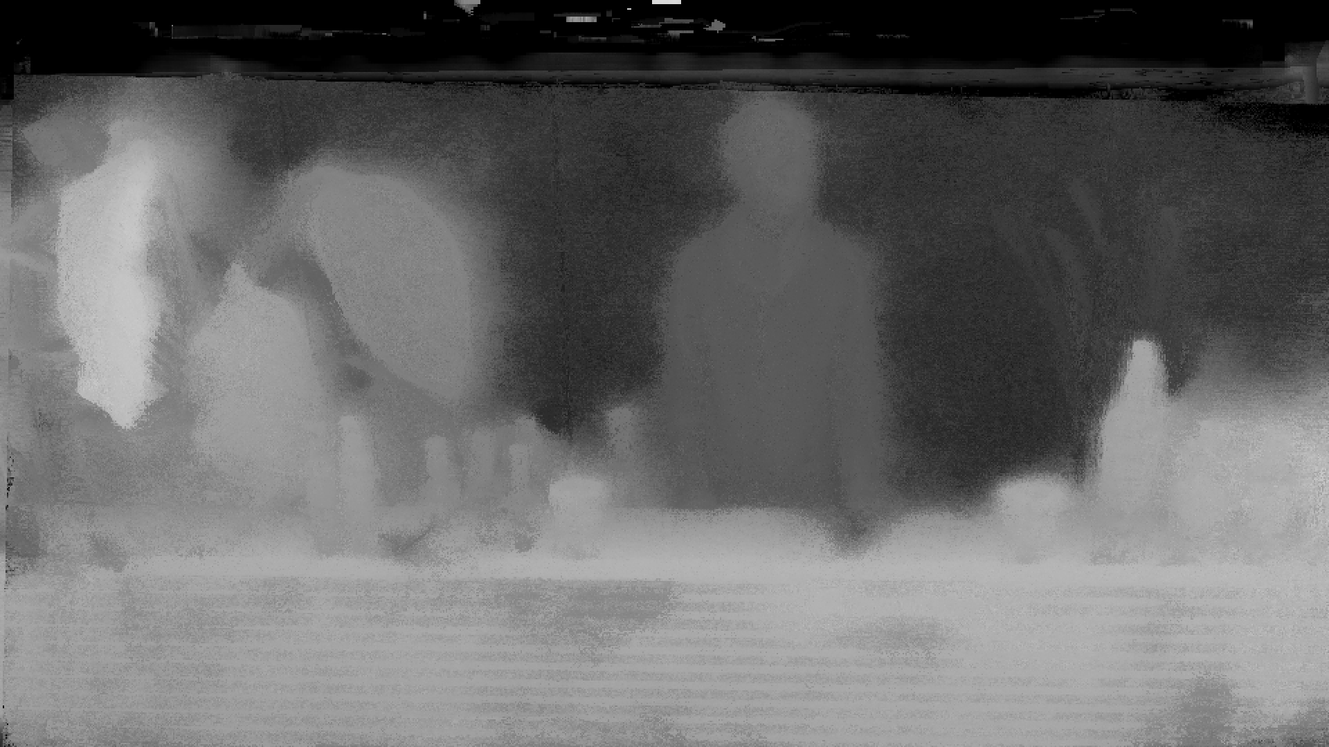
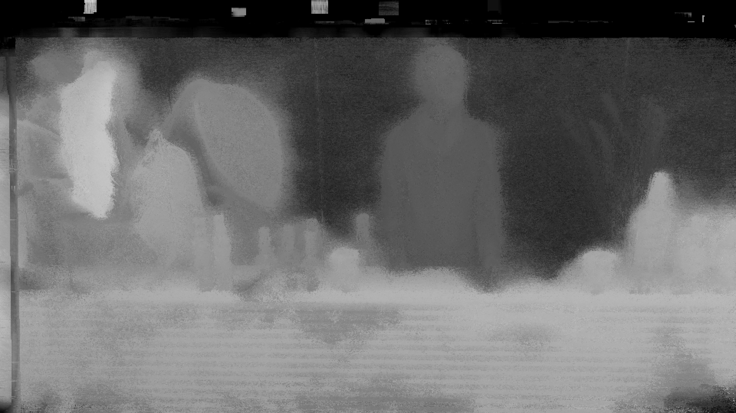
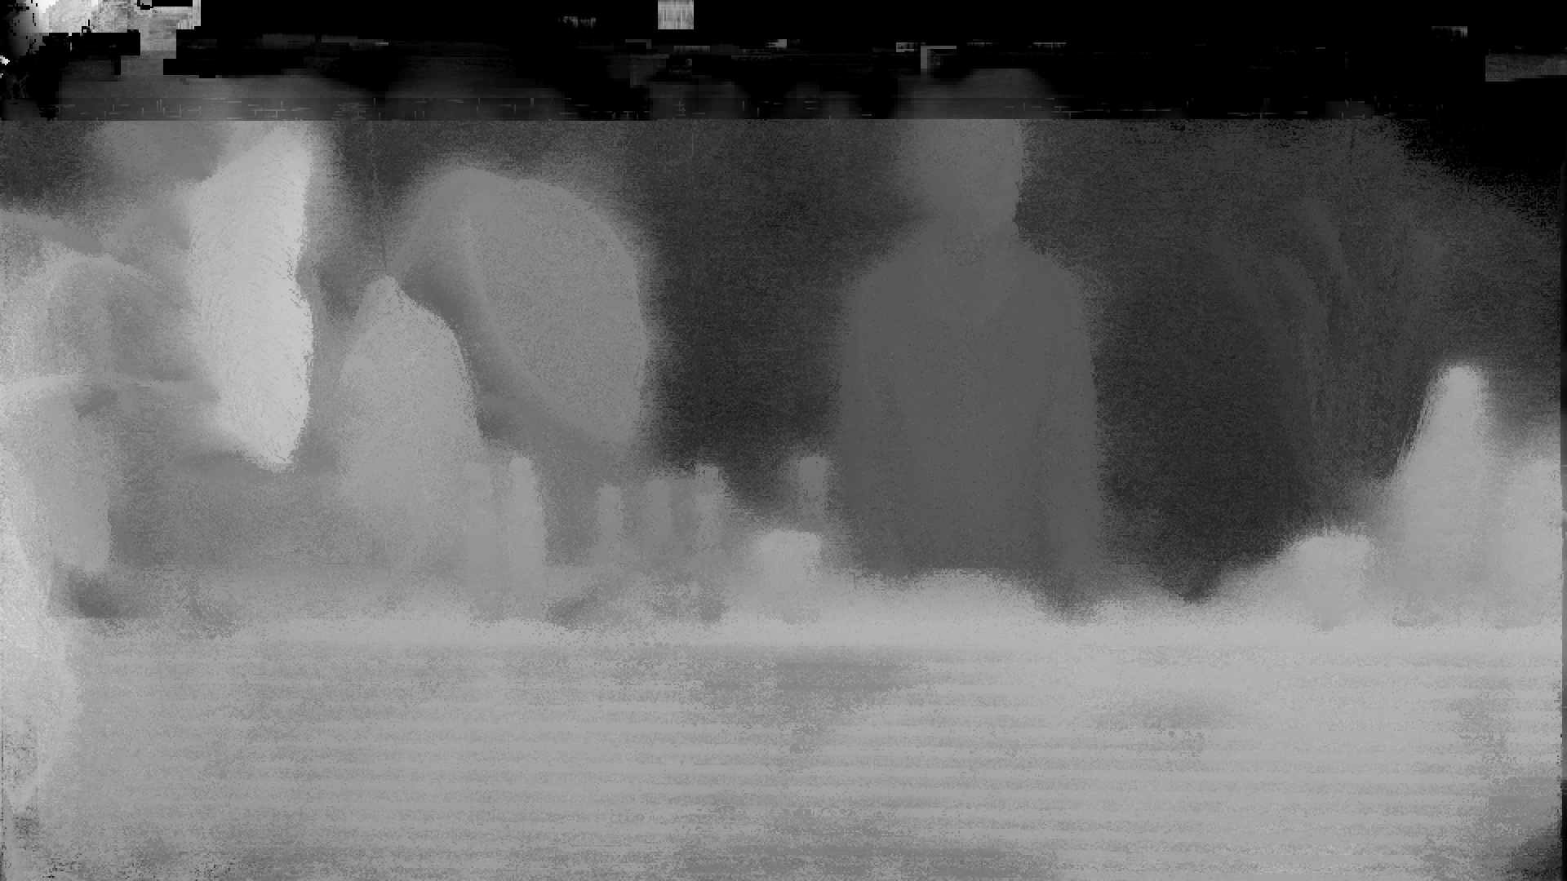
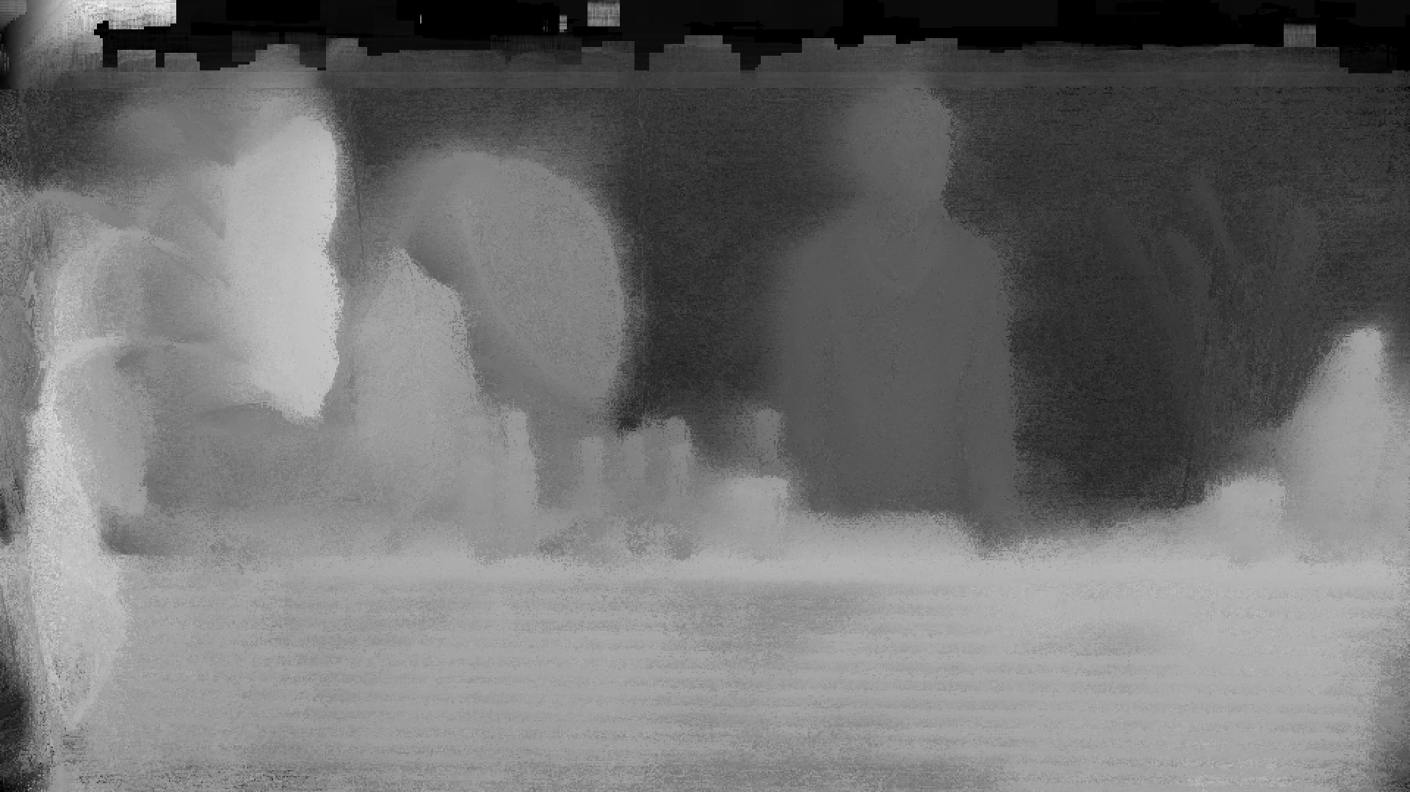










Consolidation
Problem: consistency!

Slide 18
Consolidation
Reproject

Slide 19








Upsampling
$${D_{i}}^{(j)}$$
$${D_{i}}^{(j)}$$
$${C_{i }}^{(j)}$$
$${↑D_{i}}^{(j)}$$

Slide 20




Upsampling
What disparities should be taken to the next level?
$$w\left(x,y\right)=$$
$${C_{i }}^{\left(j\right)}(y)$$
$$w_{s}(x,y)$$
$$w_{a}(x,y)$$
$${D_{i}}^{(j)}$$
Confidence
Proximity
$${↑D_{i}}^{(j)}$$
Appearance

Slide 21

Dense Light Field Results
SGM
CVF
Wang
Our method

Slide 22

Dense Light Field Results

Slide 23

Sparse Light Field Results

Slide 24



Sparse Light Field Results
SGM
CVF
Our method

Slide 25

Result videos

Slide 26

Light Field Media Production

Slide 27


Conclusion
Multiple depth maps for sparse light fields
Light field video processing in non offline process
Possible applications
First dataset for sparse light field video

Slide 28
Thank You
Efficient Multi-image Correspondences for On-line Light Field Video Processing
Project page: http://resources.mpi-inf.mpg.de/LightFieldVideo/index.html
http://www.iis.fraunhofer.de/lightfield
Contact: lukasz.dabala(at)gmail.com
frederik.zilly(at)iis.fraunhofer.de

