Slide 1
A Perceptual Model for Disparity
Piotr Didyk
MPI Informatik, Germany
Tobias Ritschel
Télécom ParisTech
Intel Visual Computing Institute
Elmar Eisemann
Télécom ParisTech
Karol Myszkowski
MPI Informatik, Germany
Hans-Peter Seidel
MPI Informatik, Germany
Notes:
Thank you for the introduction and let me start with my presentation. I will talk today about a perceptual model for disparity which was developed together with Tobias Ritschel and Elmar Eisemann from Telecom PariTech as well as Karol Myszkowski and Hans-Peter Seidel from Max-Planck Institute.

Slide 2

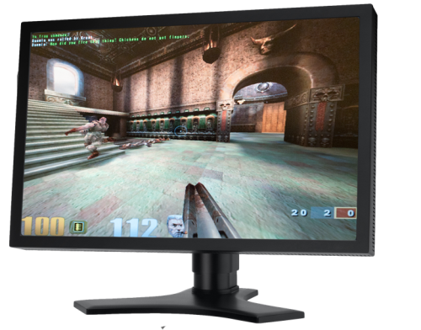





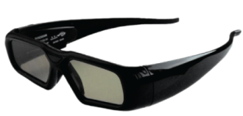

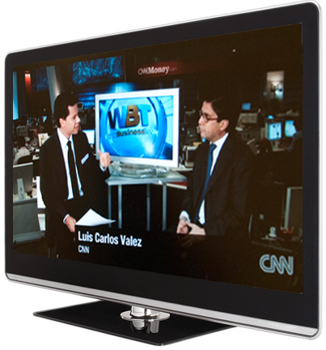


Stereo in daily life
Anaglyph
Shutter glasses
Autostereoscopic
Notes:
Nowadays, many different stereo devices are available. They allow for enjoying variety of 3D content such as movies, games and even 3D TVs.

Slide 3
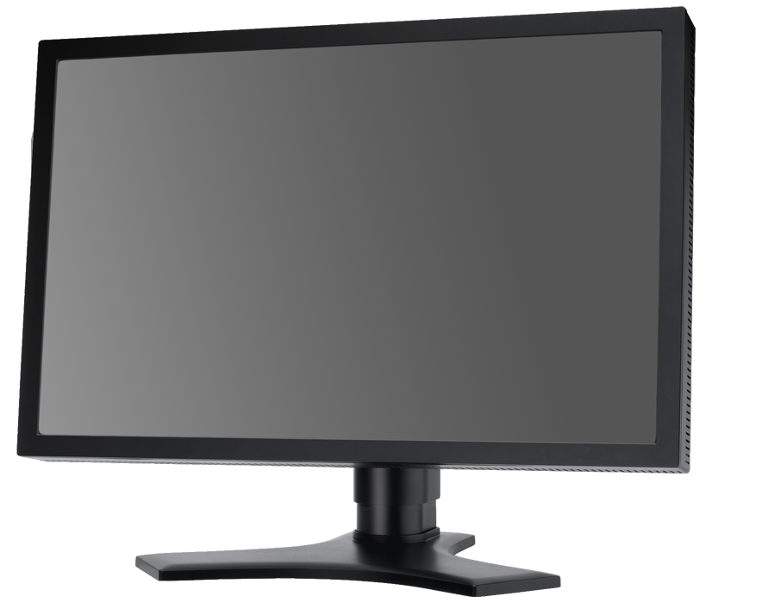
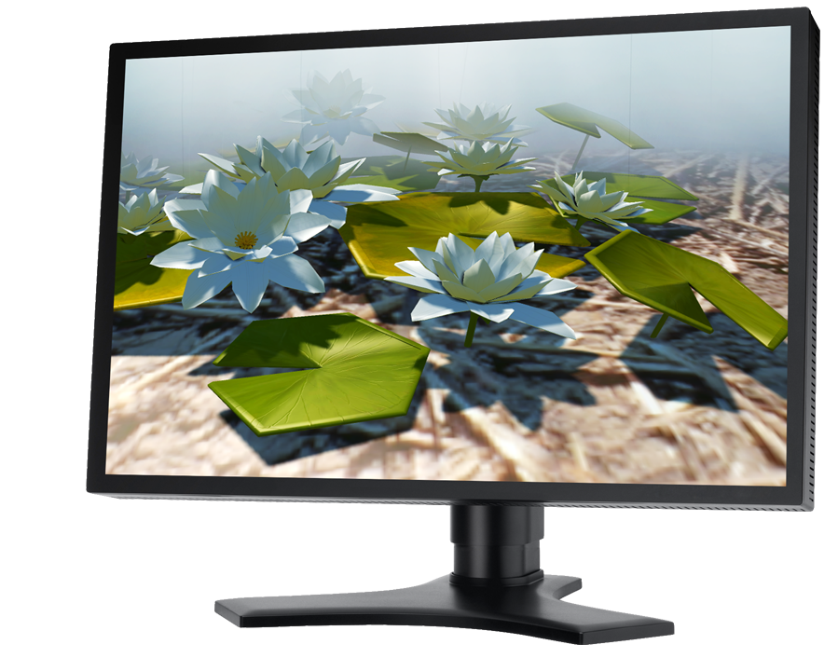
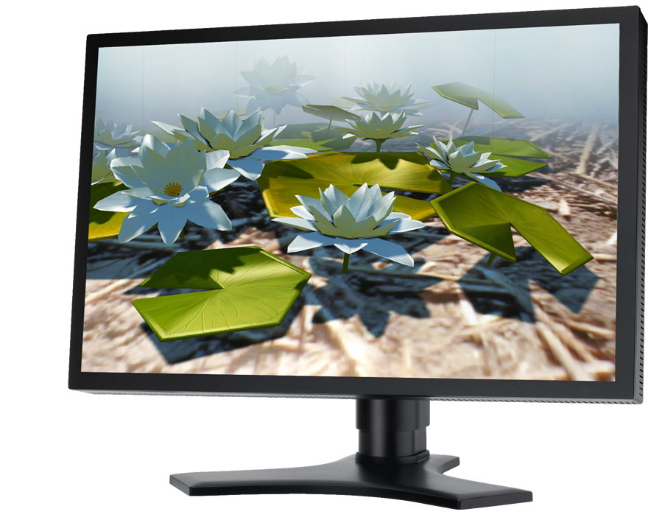
Stereo on a flat display
Different image for each eye
Left Eye
Right eye
Notes:
The stereo impression is usually achieved by showing two different images to both eyes. This works

Slide 4
Depth perception
We see depth due to depth cues.
Stereoscopic depth cues:
binocular disparity
Notes:
Due to binocular disparity cue, which accounts for the fact that the projection of two objects located at different depths is different in both eyes.
However this is not the only cue that is used by the human visual system for determining depth.

Slide 5
Depth perception
We see depth due to depth cues.
Stereoscopic depth cues:
binocular disparity
Ocular depth cues:
Vergence
accommodation,
vergence
Notes:
Other group of depth cues is related to the way our eyes are build. It consists of accommodation, which relies on the shape of lenses in our eyes which changes, while we adopt to different depth, and vergence – the angle between optical axes.

Slide 6
Depth perception
We see depth due to depth cues.
Stereoscopic depth cues:
binocular disparity
Ocular depth cues:
accommodation,
vergence
Pictorial depth cues:
occlusion,
size,
shadows…
Notes:
We also have higher order depth cues called pictorial depth cues, such as occlusion, size of objects which makes big object appearing closer to the observer or shadows, which placed differently can modify depth impression significantly.

Slide 7
Depth perception
We see depth due to depth cues.
Stereoscopic depth cues:
binocular disparity
Challenge:
Consistency is required!
Ocular depth cues:
accommodation,
vergence
Pictorial depth cues:
occlusion,
size,
shadows…
Notes:
What is challenging here, is that during 3D content preparation a care has to be taken to make all those cues consistent.

Slide 8
Depth perception
We see depth due to depth cues.
Stereoscopic depth cues:
binocular disparity
Require 3D space
Ocular depth cues:
We cheat our Human Visual System!
accommodation,
vergence
Pictorial depth cues:
Reproducible on a flat displays
occlusion,
size,
shadows…
Notes:
This, however is not that easy.
Whereas, reproducing pictorial depth cues is relatively easy as they are defined in the 2D image space, ocular cues as well as stereoscopic require 3D space.
Therefore, in order to reproduce them on the flat screen we need to cheat the Human Visual System.

Slide 9

Cheating our HVS
Accommodation
(focal plane)
Screen
Object in right eye
Viewing discomfort
Vergence
Pixel disparity
Comfort zone
Object in left eye
Object perceived in 3D
Depth
Notes:
To understand it please let us consider two eyes looking at the screen. For one of them the object is displayed in one place, for the other the place is lightly shifted. We call the displacement on the screen a pixel disparity.
In this case the object will be perceived in front of the screen. However, although the vergence depth cue stays in agreement with our scene, the accommodation tells that the object is on the screen plane, as our eyes accommodate to the screen depth.
This contradiction causes a viewing discomfort, which can be tolerated within a close distance to the screen, which is called comfort zone.

Slide 10
Depth manipulation
Comfort zone
Scene manipulation
Viewing discomfort
Viewing comfort
Notes:
To assure the comfort during 3D viewing, the scene needs to be adjusted in a way that all objects that are outside the comfort zone are brought into its interior.

Slide 11
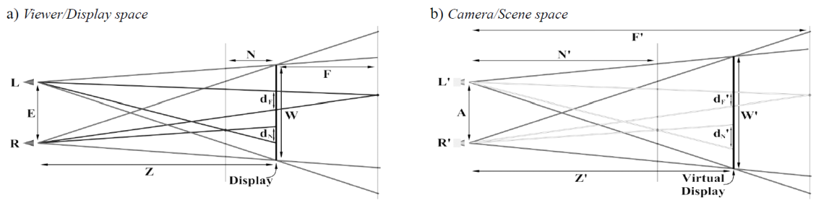
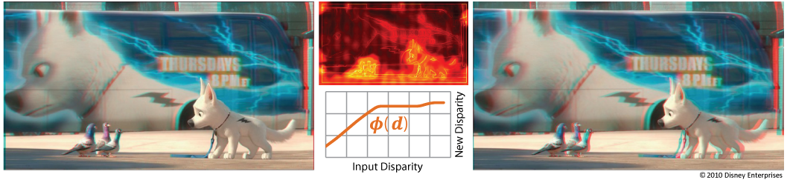
Scene manipulation
Camera manipulation
“Controlling Perceived Depth in Stereoscopic Images” by Graham et al. 2001
Disparity manipulation
“Nonlinear Disparity Mapping for Stereoscopic 3D” by Lang et al. 2010
Notes:
And this is actually what people are trying to do. For example Graham et al. presented a method for controlling the camera parameters in order to assure that the depth in the scene does not excide the comfort limits.
A bit different approach was presented at Siggraph last year, where Lang et al. presented a method for nonlinear mapping of pixel disparity into comfort range.

Slide 12
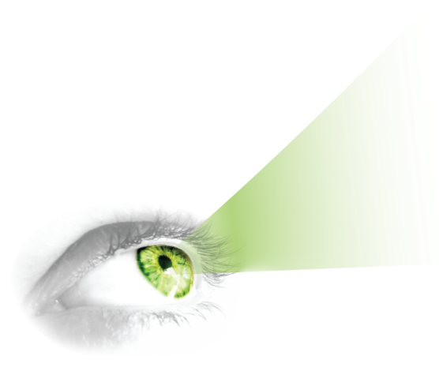
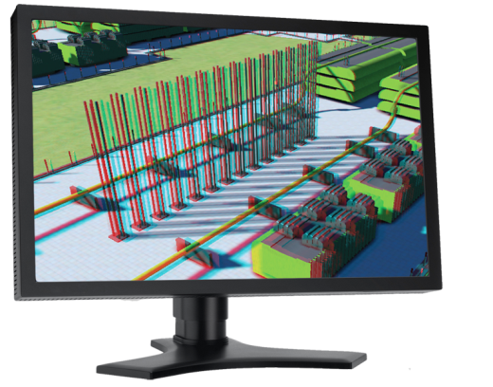
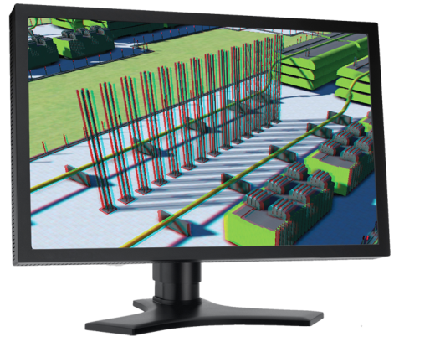
Scene adjustment
?
?
?
Scene
adjustment
Notes:
Although, such methods are powerful in removing discomfort, it is unknown what is the impact of such manipulation on perceived depth.

Slide 13
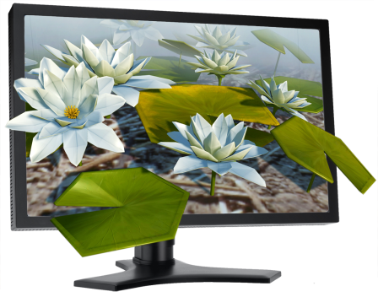
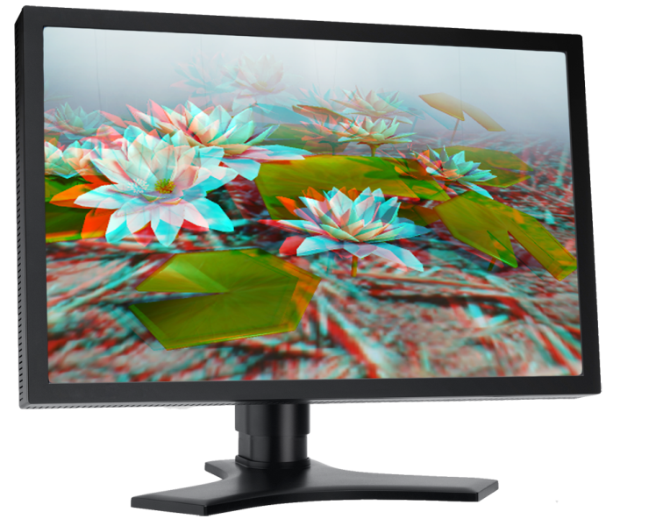
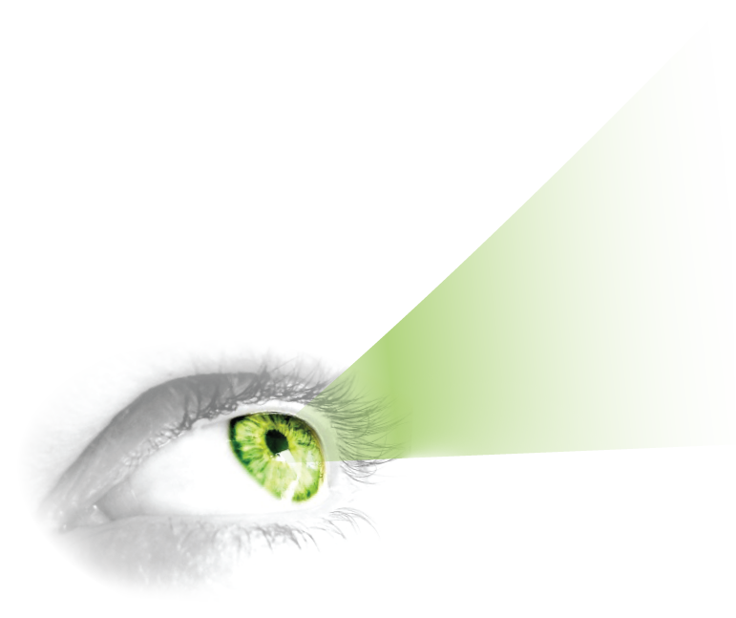
3D image prediction
?
Notes:
Therefore, it is crucial to understand and be able to predict the human visual system response to 3D images.

Slide 14
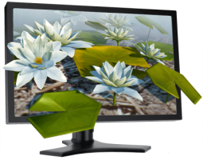

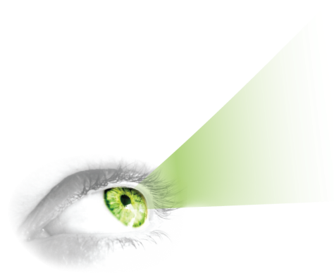




Why to predict the HVS response?
$→$ compare 3D images
$→$ better scene manipulation techniques
$→$ remove imperceptible information
$→$ …
Check what is visible
Notes:
This would allow comparing 3D images and measure impact of disparity manipulations as well as developing better techniques for such purpose.
We could also for example detect unperceivable signal and remove it for compression purpose.
There are also other application that I will talk about later.

Slide 15





Depth perception
Stereoscopic depth cues:
binocular disparity
Model
Ocular depth cues:
accommodation,
vergence
Pictorial depth cues:
occlusion,
size,
shadows…
Notes:
As I mentioned before human depth perception is a complex phenomenon, which makes it difficult to account for all depth cues at the same time.
In our work we consider one of the most important and appealing depth cue – binocular disparity and build a model which can predict a response of human visual system to this signal.
Let us see what is the information that such a model should be able to provide…

Slide 16
Disparity perception
Depth difference
Depth
Notes:
for given objects distanced in depth such model should be able to tell….

Slide 17
Disparity perception
Is it noticeable?
How significant
is the difference?
Depth difference
Depth
Notes:
Whether the depth difference is visible and if yes, how significant it is.

Slide 18



Disparity perception
$$α$$
Is it noticeable?
How significant
is the difference?
$$β$$
Depth difference
$$disparity= \left|α−β\right|$$
Depth
Notes:
This however does not directly depend on depth.
It depends on how objects are projected on our retina which can be defined by disparity which is a difference of vergence angles.
However, for presentation purpose let us first consider depth differences and be back to disparity later.
If we want to determine whether a difference in depth between two objects is visible ….

Slide 19
One just-noticeable difference
Detection threshold
(1 JND)
No difference
Just noticeable
Depth
Notes:
We need to consider two objects.
The question now is, how far me need to move one of those objects in order to see a depth change.
The smallest depth difference that needs to be introduced to make it perceivable is called a just noticeable difference (JND) or detection threshold.

Slide 20
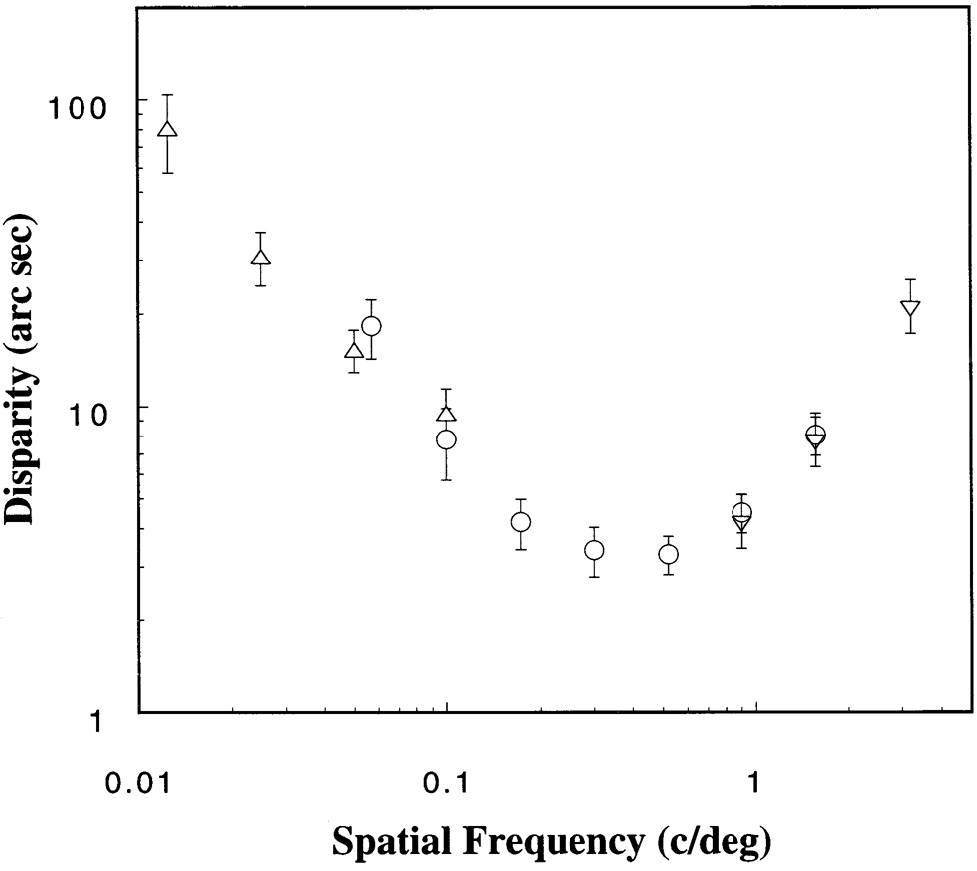
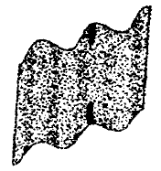



How big is the detection threshold?
$$α$$
$$β$$
$$disparity= \left|α−β\right|$$
For sinusoidal depth corrugation
“Sensitivity to horizontal and vertical corrugations
defined by binocular disparity.”
by Bradshaw et al. 1999
Notes:
People already studied this threshold. For example Bradshaw et al. measured it in terms of disparity for different sinusoids and showed that the threshold depends on the spatial frequency of depth corrugation.

Slide 21
Disparity perception
How significant
is the difference?
Is it noticeable?
Depth difference
Depth
Notes:
However, remember, we do not only want to know whether the difference is visible but also how significant it is.

Slide 22
Discrimination threshold
Existing
depth difference
depends on the previous
amplitude
Just noticeable
Depth
Notes:
For this, having the two object distanced in depth we want to know how much one of those objects needs to be moved in order to see the increase of depth.
This is called discrimination threshold and it depends on the existing depth.

Slide 23
Disparity perception
Sensitivity to depth changes depends on:
Spatial frequency of disparity corrugation
Existing disparity (sinusoid amplitude)
Sufficient measurements did not exist.
Notes:
To summarize, our sensitivity to depth changes, depends on spatial frequency of depth corrugation as well as the depth that is already present.
Because such measurements do not exist, for the purpose of our model, we prepared an experiment to measure them.

Slide 24

Measurements
Sinusoid in depth
Parameter space:
Threshold
1. Sample the space
Frequency
3. Measure thresholds
Experiment with adjustment task
Amplitude (disparity)
Notes:
Similarly to work by Bradshaw we performed our measurements for sinusoids.
Our measurement space is defined by frequency as well as amplitude of disparity corrugation.
We first sample the space, where each sample represents a different sinusoid and then measure the threshold for each of them using adjustment task.

Slide 25
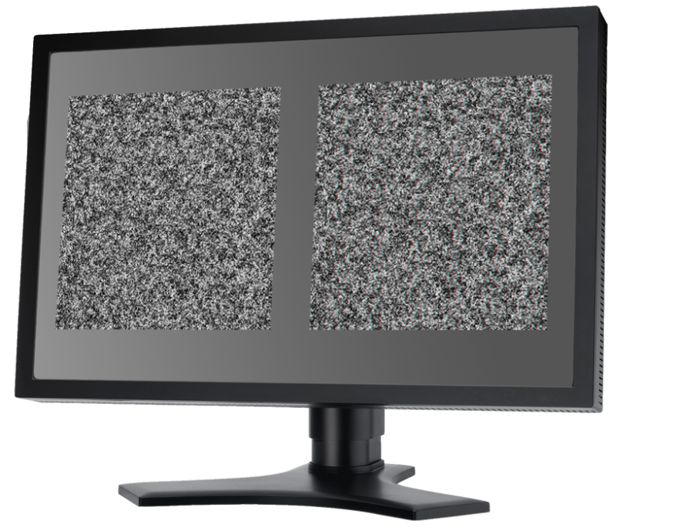
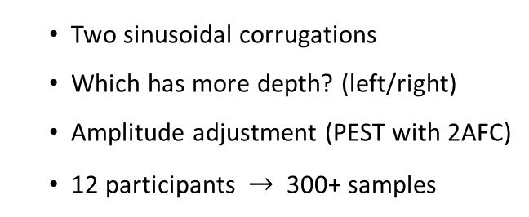
Measurements
threshold
Thresholds measurement:
Two sinusoidal corrugations
Which has more depth? (left/right)
Amplitude adjustment (PEST with 2AFC)
12 participants $→$ 300+ samples
Notes:
To measure the threshold we show on the screen two sinusoids: one defined by our sample and one with increased amplitude.
By manipulating the amplitude difference and asking people which sinusoid is deeper we can find the smallest difference of amplitude that is perceivable.
In our study 12 participants took part and we collect over 300 thresholds for different sinusoids.
Later we fit a analytic function ….

Slide 26
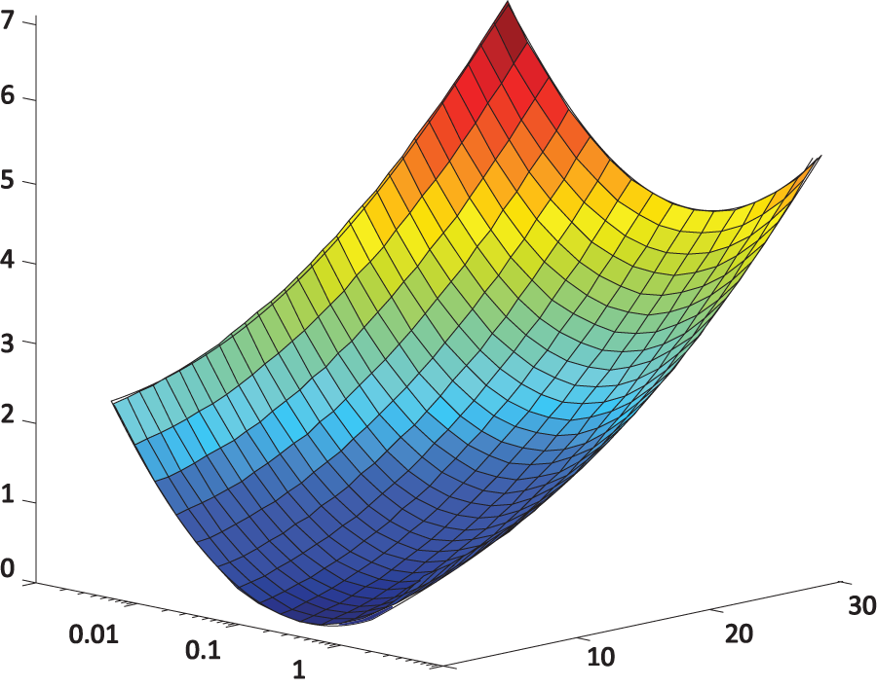
Model
Threshold [arcmin]
3. Fit analytic function
Frequency [cpd]
Amplitude [arcmin]
Notes:
To cover all possible sinusoids.

Slide 27
The HVS response
Disparity sensitivity
Threshold [arcmin]
Threshold [arcmin]
The HVS response?
Frequency [cpd]
Amplitude (disparity)[arcmin]
Disparity [arcmin]
Notes:
Now, having our model we want to compute a response of the human visual system to arbitrary signal.
Let us for the beginning consider a slice through our model along the amplitude axes.

Slide 28
The HVS response
Disparity sensitivity
Perceived as different
Threshold [arcmin]
Disparity [arcmin]
Depth
Notes:
If you remember from previous slides, the function is defined for one frequency. For a sinusoid defined by a amplitude gives the smallest this difference in amplitude that needs to be added in order to create a sinusoid which will be perceived as deeper.

Slide 29
The HVS response
Disparity sensitivity
1 JND
1 JND
1 JND
1 JND
Threshold [arcmin]
4 JND
How significant is the difference?
Disparity [arcmin]
Notes:
Let us forget for a while that this function is only for a sinusoid and consider two object between which we want to measure the depth difference in terms of just noticeable differences.
First, we can ask how much we need to push the first object to create 1 JND difference. But please remember that this is exactly what our function tells us. We just need to take a value and this will be our 1 JND.
Now we can find out in similar way where we would need to place another object to create 2JND difference to the one that we added previously.
Following this procedure we can place many objects where each of them will be 1JND further. At some point we reach the object that we want to measure distance to. At this point we need to count all JNDs and we get a difference expressed in just noticeable differences units.

Slide 30
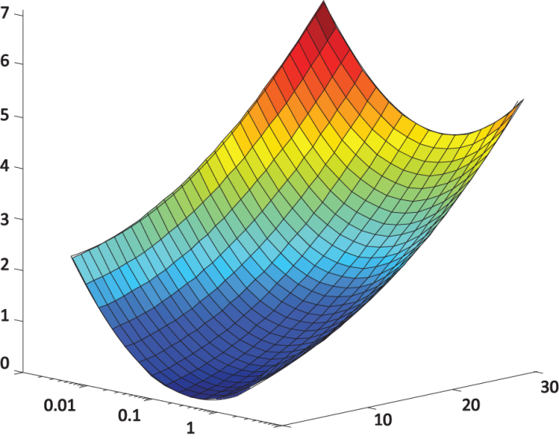
The HVS response
Transducers
5
4
Threshold [arcmin]
3
Response [JND]
2
1
Frequency [cpd]
Amplitude [arcmin]
Disparity [arcmin]
“A transducer function for threshold and suprathreshold human vision” by Wilson 1980
“A perceptual framework for contrast processing of high dynamic range images” by Mantiuk et al. 2005
Notes:
However, it is not required to repeat the procedure every time we want to compute such a difference.
Using similar procedure we can compute so called transducers, which for each frequency, map directly disparity to response expressed in JND units.
More details can be found in works by Wilson or Manituk et al. where such transducers were built for contrast in luminance.

Slide 31

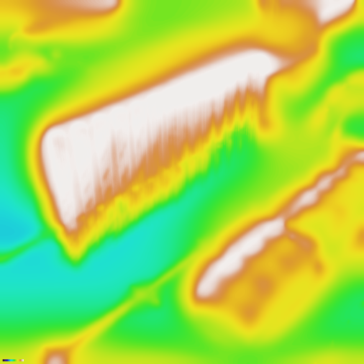
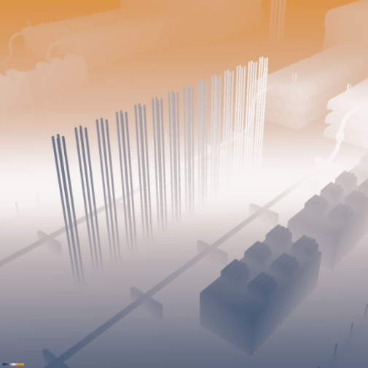
Perceptual space
Our problem:
We show so far:
strong
10px
HVS response
[JND]
(disparity, frequency)
[arcmin, cpd]
weak
-10px
3D scene with pixel disparity
[pixels]
Map of HVS response
[JND]
Notes:
So far I showed how for given disparity and frequency compute the response of the human visual system.
However, in fact we need to deal with complex 3D scenes with pixel disparity for which we want to obtain a spatially varying map of the human visual system response.

Slide 32


Perceptual space
Our problem:
Problems:
strong
Pixel disparity [pixels] $↔$ Disparity [arcmin]
Sinusoidal patterns $→$ Complex images
weak
3D scene with pixel disparity
[pixels]
Map of HVS response
[JND]
Notes:
Remember we illustrated everything in depth differences but in fact we need to have disparity measured in angles
There are two problems. First we need to show how from pixel disparity one can compute disparity expressed in angles and second, how to use our measurements and model for sinusoids to deal with complex images.

Slide 33

Pixel disparity to disparity
$$α$$
$$β$$
$$disparity= \left|α−β\right|$$
Notes:
What is interesting from the point of view of disparity perception is disparity measured in angles.

Slide 34
Pixel disparity to disparity
Pixel disparity
$$α$$
Screen distance
Interaxial
$$β$$
Pixel disparity
$$\left(viewing conditions, pixel disparity\right)→vergence$$
Notes:
What we actually have is pixel disparity.
However, assuming a viewing condition: interaxial and screen distance.
We can easily compute vergence.

Slide 35
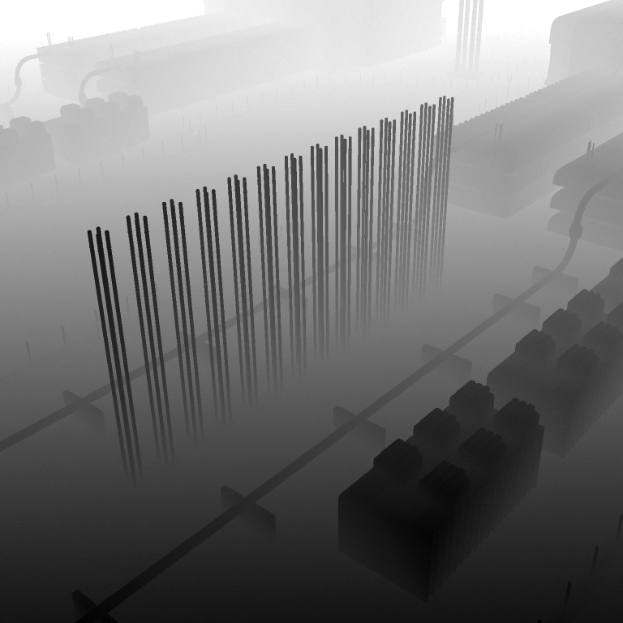
Vergence to disparity
Disparity [arcmin]
How do people deal with luminance?
Vergence [arcmin]
Notes:
and we can assume that we have a map of vergence and now we want to compute disparity.
To explain it, let us take a quick look how things are done for luminance, which some of you might be familiar to.

Slide 36
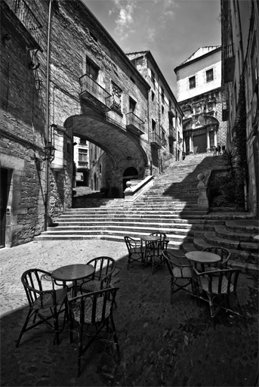
Luminance (contrast perception)
Perceptual space
(Perceived contrast)
Luminance
Notes:
Usually, for luminance, we have an image, and we also want to obtain a perceptual space which usually expresses perceived contrast.

Slide 37



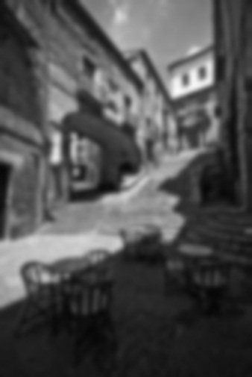
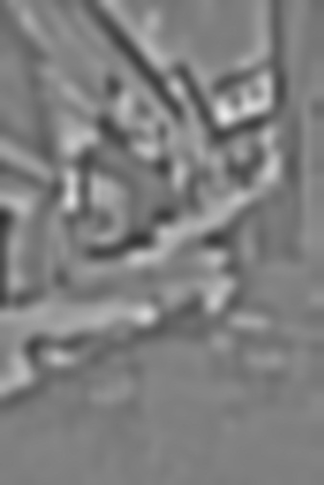

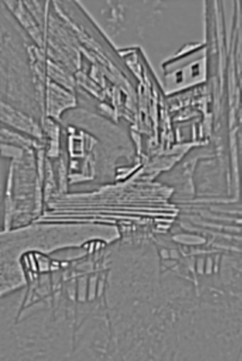

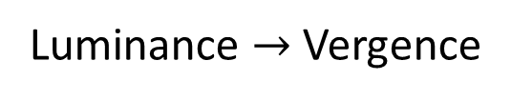
Luminance (contrast perception)
Works because:
Disparity / Luminance similarity:
Different frequencies are processed separately.
Luminance $→$ Vergence
For disparity is similar.
Disparity is processed in independent channels.
“Seeing in depth” by Howard and Rogers 2002
Luminance contrast $→$ Disparity
Lowpass filters
Contrast decomposed into frequency bands
Perceptual operations
Notes:
One of approach, is to compute a series of low pass filters and then compute differences between them, obtaining contrast decomposition into frequency bands.
In such decomposition perceptual operations are later possible.
Such approach is possible because different receptive fields in our brain are tuned to different spatial frequencies.
Therefore, each frequency can be considered independently.
It turns out that this hold also for disparity.
So in our case we can consider vergence as luminance and disparity as luminance contrast.
This correspondence allows us applying similar technique for our purpose.

Slide 38







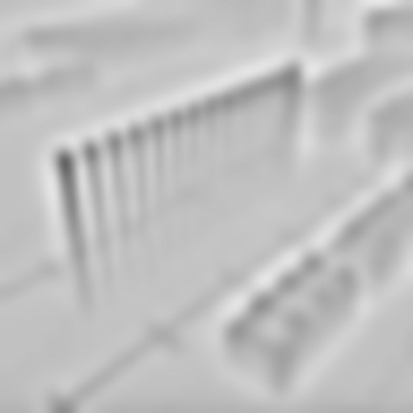
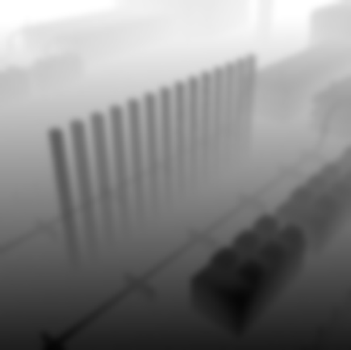
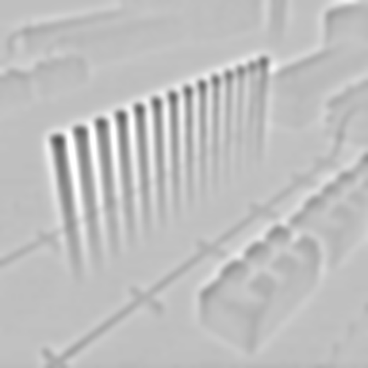

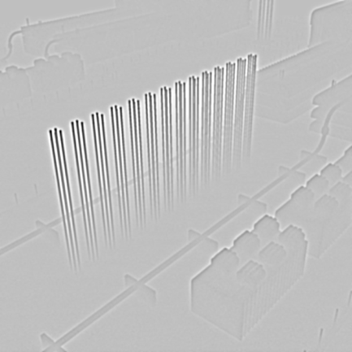
Vergence to disparity
Vergence [arcmin]
Lowpass filters
Differences
Notes:
To this end, we take the vergence map and compute a number of different low pass filters.
Then we compute difference between them.

Slide 39

Vergence to disparity
Laplacian decomposition
We can process frequencies independently
Lowpass filters
Differences
Vergence $→$ Disparity
Notes:
Doing so, on one hand we separated different frequency channels which make our measurements for sinusoids applicable.
And on the other hand because we computed difference of vergence, in our decomposition we obtain disparity.
Having this we can take a look how our pipeline for perceptual mode looks like.

Slide 40
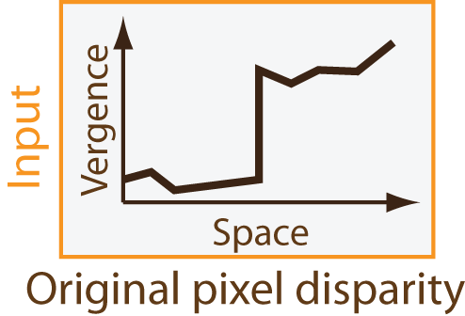
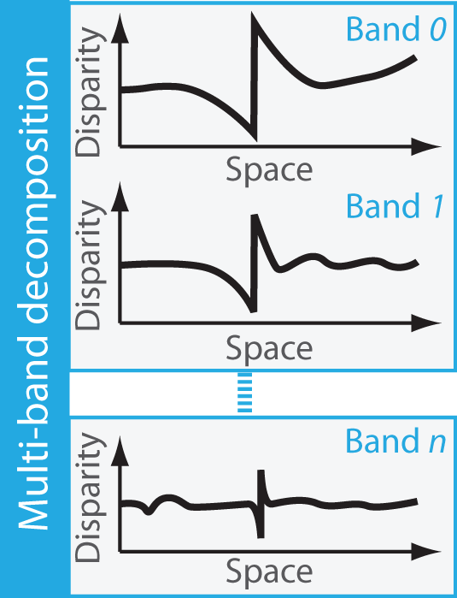
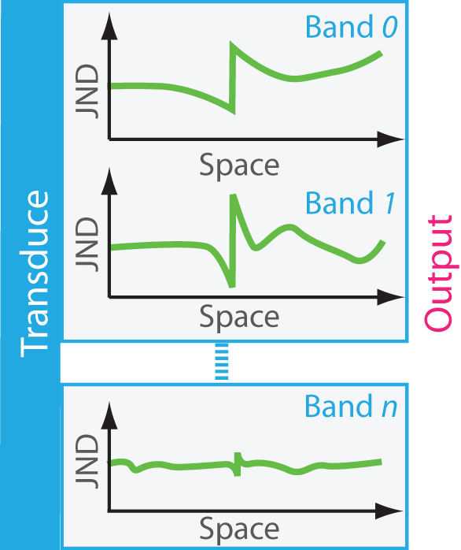
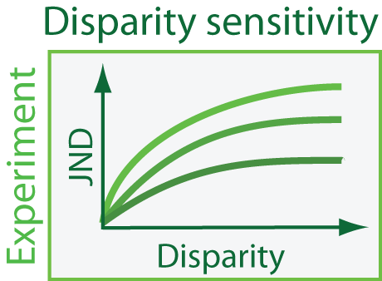
Perceptual model
Perceptual space
Notes:
First, we take a pixel disparity and transform it to vergence, which undergoes goes lapolacian decomposition.
Then we used our model to transform each of frequency channels into perceptual, jnd, space.
This decomposition we define as a perceptual space.

Slide 41
Disparity metric
?
?
?
Scene
adjustment
Notes:
Now, using perceptual space we can compute the influence of scene adjustments. To do so

Slide 42
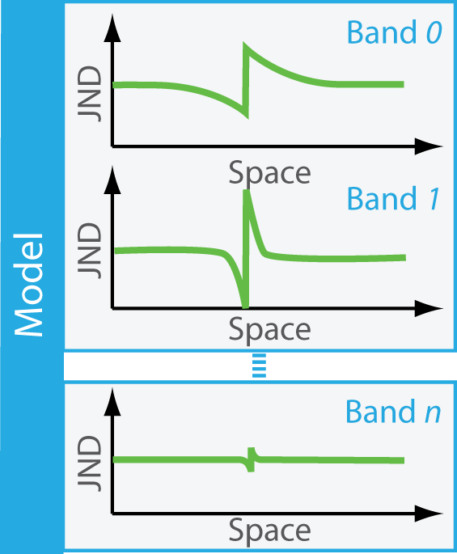
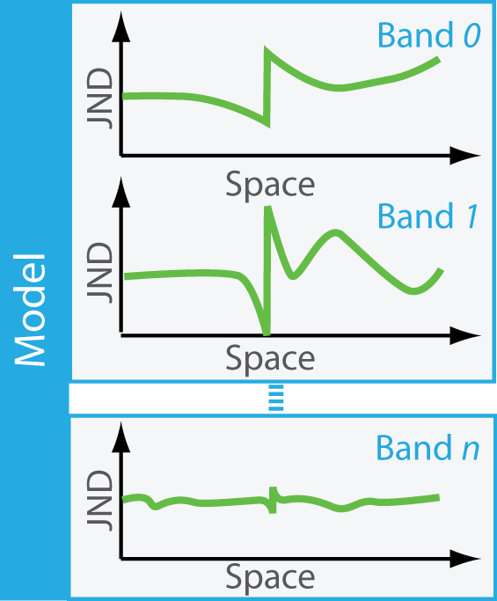
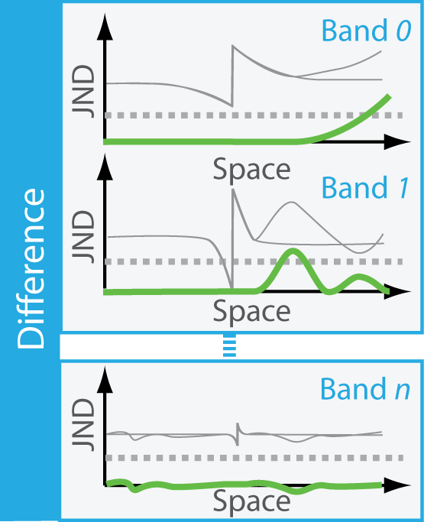

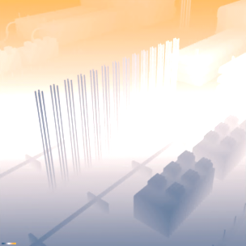
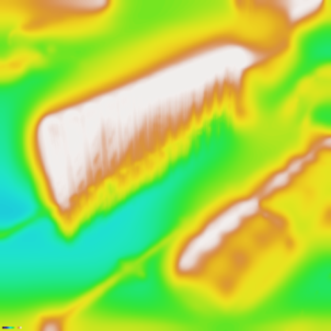
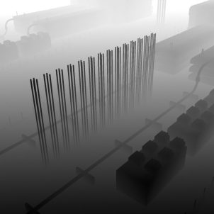
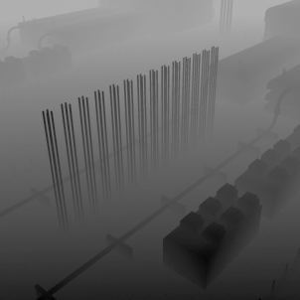
Disparity metric
strong
For Luminance:
“A visual discrimination model for imaging system design and development”
by Lubin 1995
Original
pixel disparity
Modified
pixel disparity
Original vergence
Modified vergence
Difference map
weak
Notes:
We build a metric, which works similarly to those designed for luminance, for example by Lubin.
We take an original pixel disparity compute vergence and apply our model. We do the same for modified disparity
Now, in our perceptual space we can compute a difference for each band separately.
Later we collapse decomposition obtaining a difference map.

Slide 43
Disparity compression
Threshold [arcmin]
Can be removed
Without reducing quality
Imperceptible
Frequency [cpd]
Amplitude [arcmin]
Notes:
If we look one more time on our measurements, they define a boarder between disparities that are perceptible and not. Everything which is below the curve can be removed from the 3D images without scarifying the quality. This can be used in our disparity compression method.

Slide 44
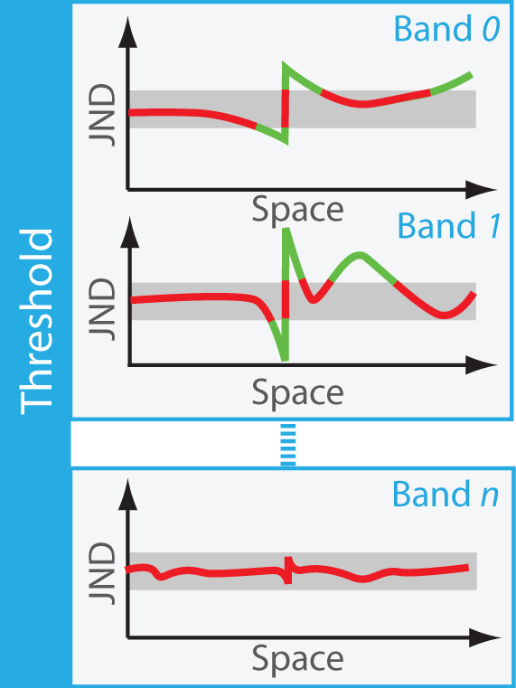
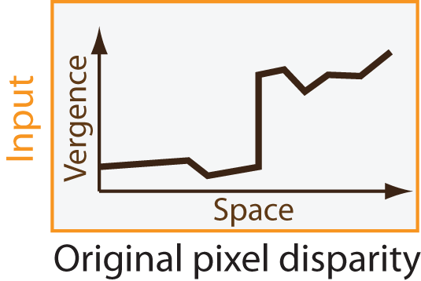
Disparity compression
Notes:
To compress disparity we can take pixel disparity, transform it into perceptual space where disparities smaller than 1 JND can be easily identified.
As standard compression techniques perform similar decomposition, if we remove there unnecessary information we reduce the amount of data that needs to be stored.
Now the question is how to get back to the pixel disparity which is what we need for computing left and right eye images.

Slide 45
Inverse model
Invertible
Perceptual space
Notes:
Fortunately, transducer functions that we compute to build our model are invertable.

Slide 46
Inverse model
Invertible
Perceptual space
Notes:
Therefore, we can inverse the pipeline and go back from perceptual space through the multiband decomposition, where we apply inverse transducers, to the pixel disparity.

Slide 47
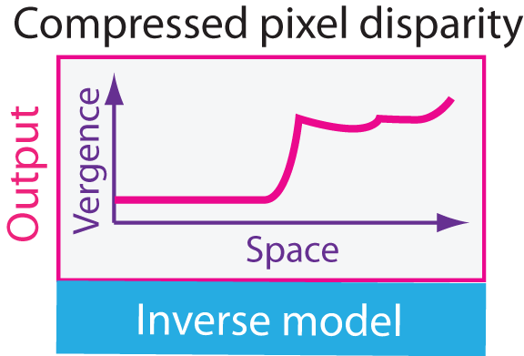
Disparity compression
Notes:
So now, to recover the pixel disparity is enough to apply our inverse model.

Slide 48
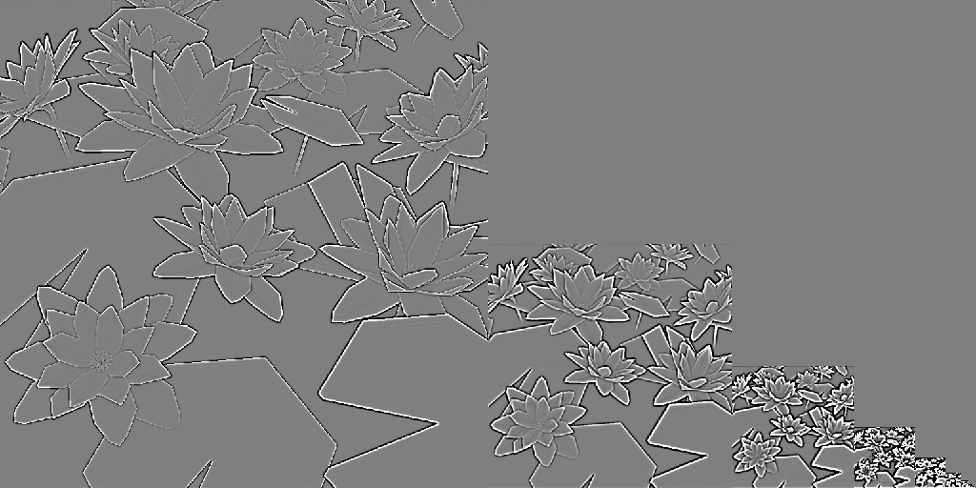
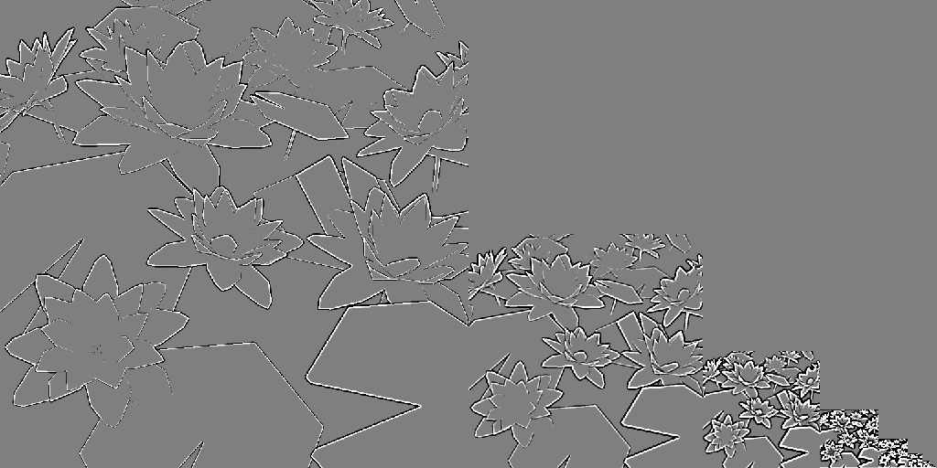








Disparity compression
Original disparity
< 1 JND removed
< 2 JND removed
< 3 JND removed
< 4 JND removed
< 5 JND removed
< 6 JND removed
< 7 JND removed
< 8 JND removed
Stereo image
Notes:
Just to give you an idea how it works, let us consider this 3D image and its frequency decomposition.
We can remove here small disparities below 1JND that anyway would be not visible.
We can also use our model to remove even more, obtaining better compression rate.
As we can determine the strength of depth as well as its visibility, we can use it to steer disparity manipulations.

Slide 49



Disparity manipulation
We can do in the perceptual space:
$→$The HVS is taken into account
$→$ Efficient disparity reduction
$→$Important disparities preserved
“Nonlinear Disparity Mapping for Stereoscopic 3D” by Lang et al. 2010
Notes:
Lang et al. showed how to perform nonlinear disparity mapping.
Doing that it perceptual space allows for taking the human visual system into account, which allows for efficient disparity reduction, preserving disparities important for our perception.
During such modification we can also account for different 3D equipment.

Slide 50












Personalization
Disparity perception depends on:
Equipment
User
Notes:
As we showed in the paper sensitivity to disparity depends on device that is used. It also depends on the viewer. When some people perceive depth well other perceive it weaker.

Slide 51





Personalization
Original disparity
Adjusted disparity
Perceptual space
Notes:
Using our model we can obtain a response for one person and a device and then using inverse pipeline and different models, we can obtain a pixel disparity, which shown to other person will result in similar depth impression.

Slide 52


Personalization
=
All users perceive the same regardless:
Equipment
Disparity sensitivity
Notes:
After such adjustment both person can perceive the same regardless equipment and their disparity sensitivity.
This of course assumed that both people have 3D equipment. However, it is not always the case.

Slide 53







Backward-compatible stereo
BAD
OK
BAD
OK
Standard stereo
Standard 2D image
Backward-compatible stereo
Notes:
When we show 3D content to the person with such an equipment, they can enjoy 3D, while at the same time a person without special equipment will see artifacts.
To satisfy the person without 3D equipment we could show 2D image, however, then the other person cannot make use of their 3D glasses.
In our work we show how to produce a backward-compatible stereo that allows for good 3D impression and minimizes the artifacts when 3D equipment is not used.
This seems to be difficult task, however, for this purpose we use the corsweet illusion.

Slide 54



Cornsweet illusion
Similar perceived contrast
Luminance range reduced
Cornsweet illusion works for depth:
“A Craik-O'Brien-Cornsweet illusion for visual depth ” by Anstis et al. 1997
Notes:
Which in luminance allow for exchanging a step function with a profile that preserves perceived contrast but reduces luminance range significantly.
It turns out that this illusion works also for disparity as shown by Anstis et al.

Slide 55
Backward-compatible stereo
Standard stereo
Backward-compatible stereo
Notes:
Therefore, we can introduce disparities using cornsweet profiles only where they are needed. This allows for producing content that appears almost ordinary to a viewer without stereo equipment and conveys 3D impression when such equipment is used.

Slide 56






Hybrid images
Frequency mixing to combine two images.
$→$ the same work for disparity
Low frequency
disparity
High frequency
disparity
From close
“Hybrid Images” by Oliva et al. 2006
From far
Notes:
Using our model we can predict response to different frequencies. Therefor, similar to work by Oliva et al. for luminance we can combine two stereo images, using low frequency from one of them and high from the other, which results in images that changes the appearance while viewed from different distances.

Slide 57
Conclusions
We present:
Measurements of discrimination disparity thresholds for different devices
A perceptual model for disparities
Applications:
  Metric
  Compression
  Personalization
  Disparity manipulation
  Backward-compatible stereo
  Hybrid images
Notes:
To conclude my talk, we presented…

Slide 58
Conclusions
Our model does not account for:
Influence of other depth cues
Luminance influence
Masking one frequency signal by another frequency
Future work

Slide 59

A Perceptual Model for Disparity
Piotr Didyk, Tobias Ritschel, Elmar Eisemann, Karol Myszkowski, Hans-Peter Seidel
The project website with demos:
http://mpii.de/resources/DisparityModel/

Slide 60







Model for different devices
Threshold
Threshold
Threshold
Frequency
Frequency
Frequency

Slide 61


Minkowski summation
$$\sqrt[k]{\sum_{i=0}^{n}{{{{Band}_{ i}}^{k}}_{ }} }$$
Visible
Minkowski summation
Perceived difference
per band
Perceived difference

