Slide 1
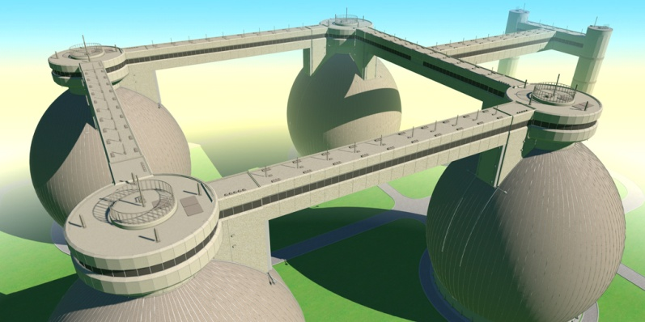
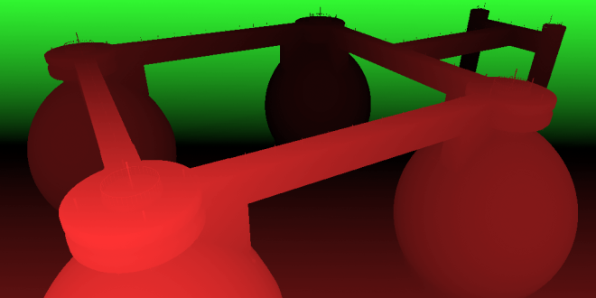
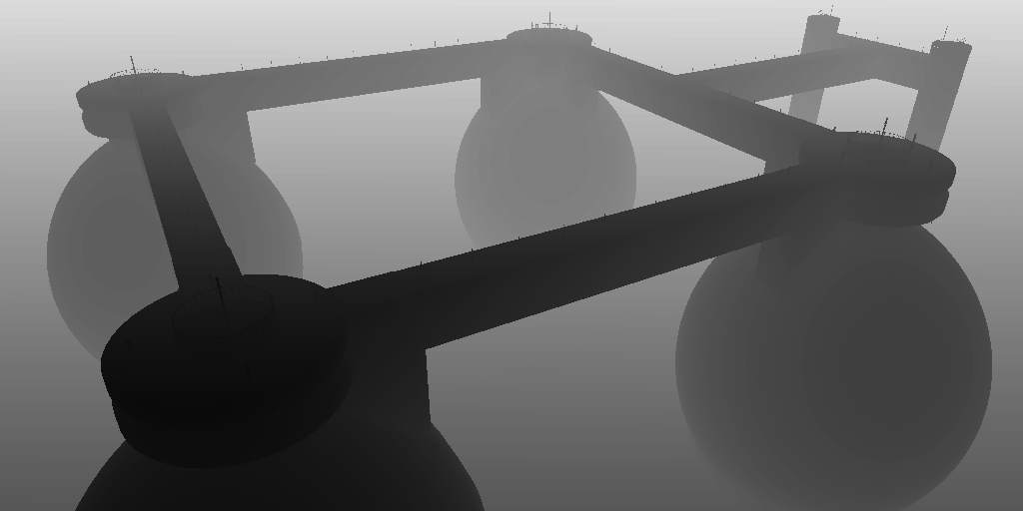
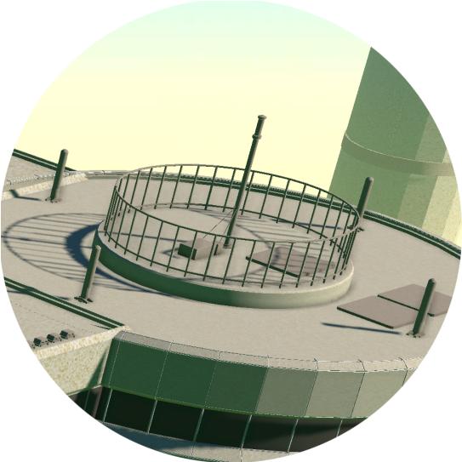

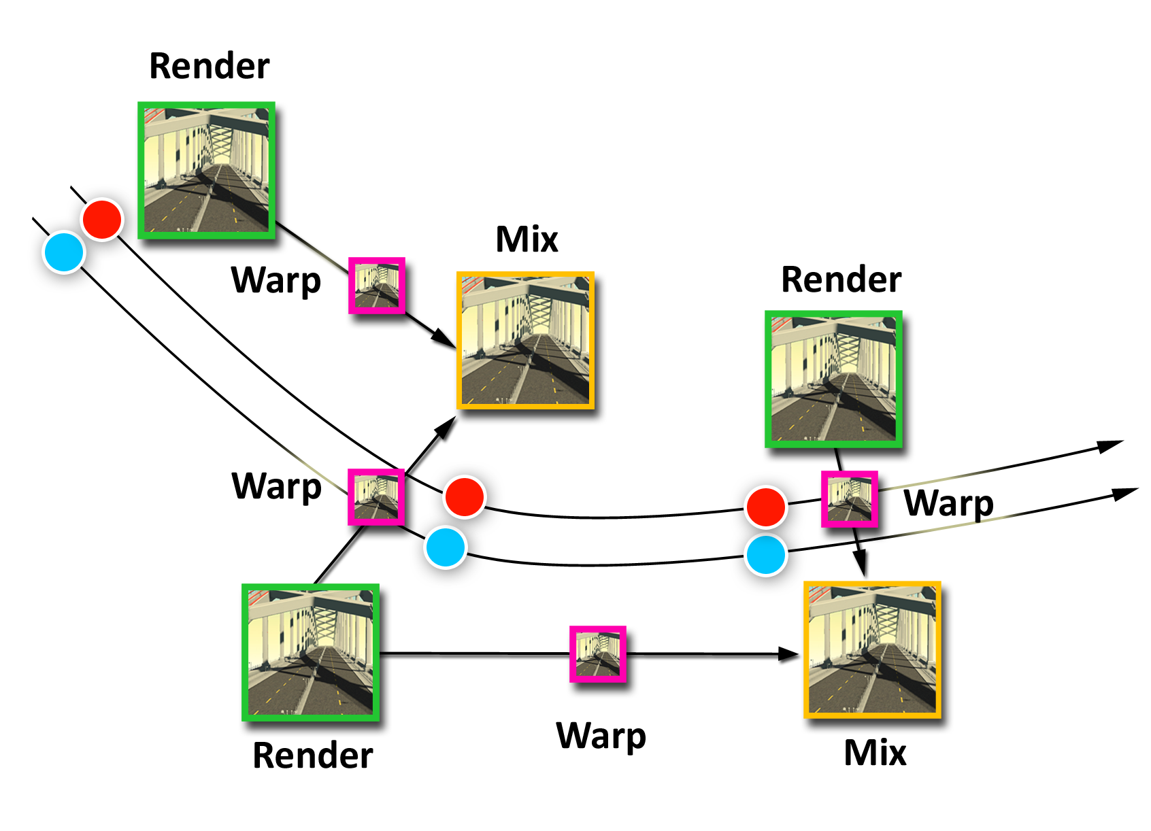
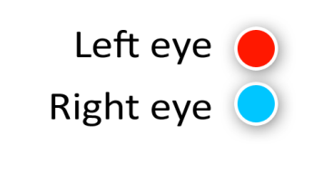
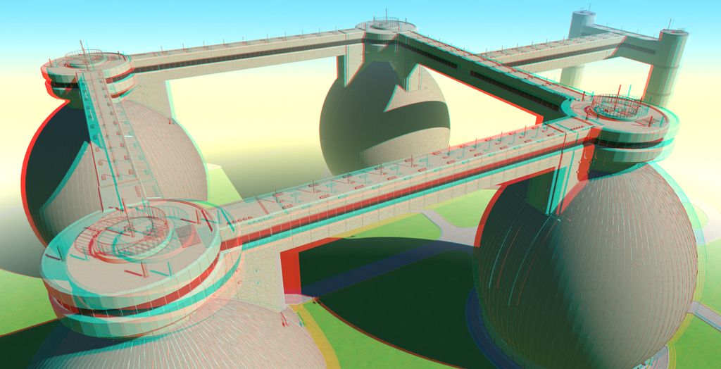
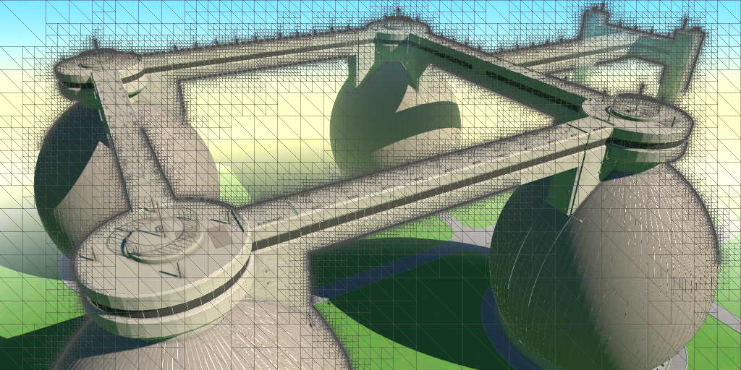
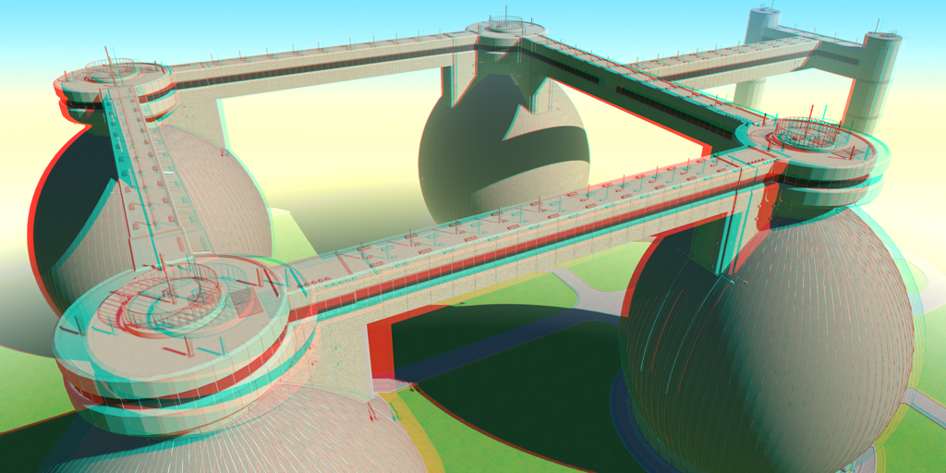
High quality rendering
Stereo
Our approach
A multi-level adaptive grid
Use of temporal domain
Rendered frame
Disparity
Depth
High rendering cost !
Half the framerate !
a couple of milliseconds
High resolution
Stereo
High framerate
Stereo image
Notes:
Nowadays there is a huge need of high quality rendering.
We want a resolution to be high for good details reproduction as well as framerate to reduce blur, make the animation smooth and allow for a better interaction.
However this increase the rendering cost drastically.
At the same time we want to make use of stereoscopic devices producing stereo content
which further lower the framerate.
The question is if we can avoid it by producing stereo images in a more efficient way.
In our work we present an image-based technique, which from a single view
and other information stored already on GPU,
in couple of milliseconds can produce
a stereo view.
To do so, from a single view and disparity map we derive in a multi-level fashion
a grid which is highly adapted to disparity discontinuities. Later morphing the grid we create the second view, which
combined with the original frame gives the final stereo image.
We also show how using the temporal domain and interleaving rendering of different views can minimize possible artifacts coming from disocclusions.

Slide 2
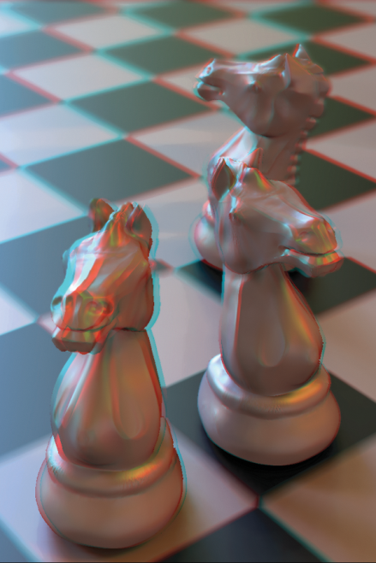

Adaptive Image-space
Stereo View Synthesis
Piotr Didyk, Tobias Ritschel, Elmar Eisemann,
Karol Myszkowski, Hans-Peter Seidel
Notes:
If you want to know more how in a fast and effective way generate a stereo view from a single view, please come and see our poster on adaptive image-space stereo view synthesis.

